Slide 1






BrainHuRo
Sistema Brain-Computer Interface (BCI) per il controllo di robot umanoidi e tecnologie assistive

Slide 2
BrainHuRo
The opportunity to have a own avatar is no longer just the prerogative of science fiction films like Avatar or Pacific Rim. In Tuscany, a group of companies and universities has created a humanoid robot controlled by thought. The project, co-financed by the Tuscany Region, saw the collaboration of different scientific and business organizations including Liquidweb (creator of BRAINCONTROL, the heart of the system BCI of the project), leader of the partnership, Humanot, Massimi sistemi, Micromecc and the University of Siena.
The goal here is not to conquer a new world but regain independence and mobility of communication of which has been deprived. In fact, a humanoid robot can help people suffering from diseases such as quadriplegia, Amyotrophic Lateral Sclerosis (ALS), multiple sclerosis, and muscular dystrophies of various kinds in the performance of daily activities such as "virtually" going around the house, watching the sunset from the window or interact with loved ones.
The software that allows the user to interface with his avatar is BRAINCONTROL (based on brain-computer interface technology), a sort of mental joystick that allows to control the computer by thought. To date the communicator (Braincontol v1.0) is commercially available and it is certified as a medical CE class I. It includes a Sentences finder and a yes / no selector. This solution fills the technological void for patients who have cognitive abilities intact, but which are not able to move and communicate even with the aid of other assistive technologies (eg. Eye tracking), called "locked-in" state.
Braincontrol v1.0 is the first step of a broader process that has the final goal to overcome not only communication disabilities, as evidenced by the result just reached with BrainHuRo.
For more information, visit www.braincontrol.com
Contacts:
LiquidWeb s.r.l.
Via Cesare Maccari, 1
53100 Siena – Italy
Tel.: +39 05771916187
Fax +39 05770831169
email: info@braincontrol.com

Slide 3
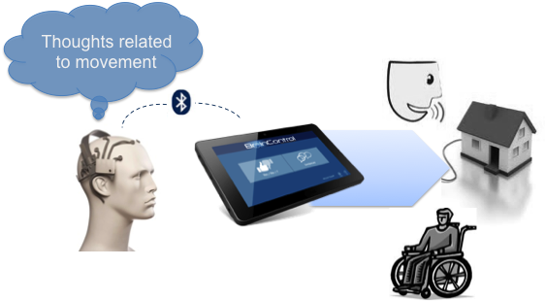
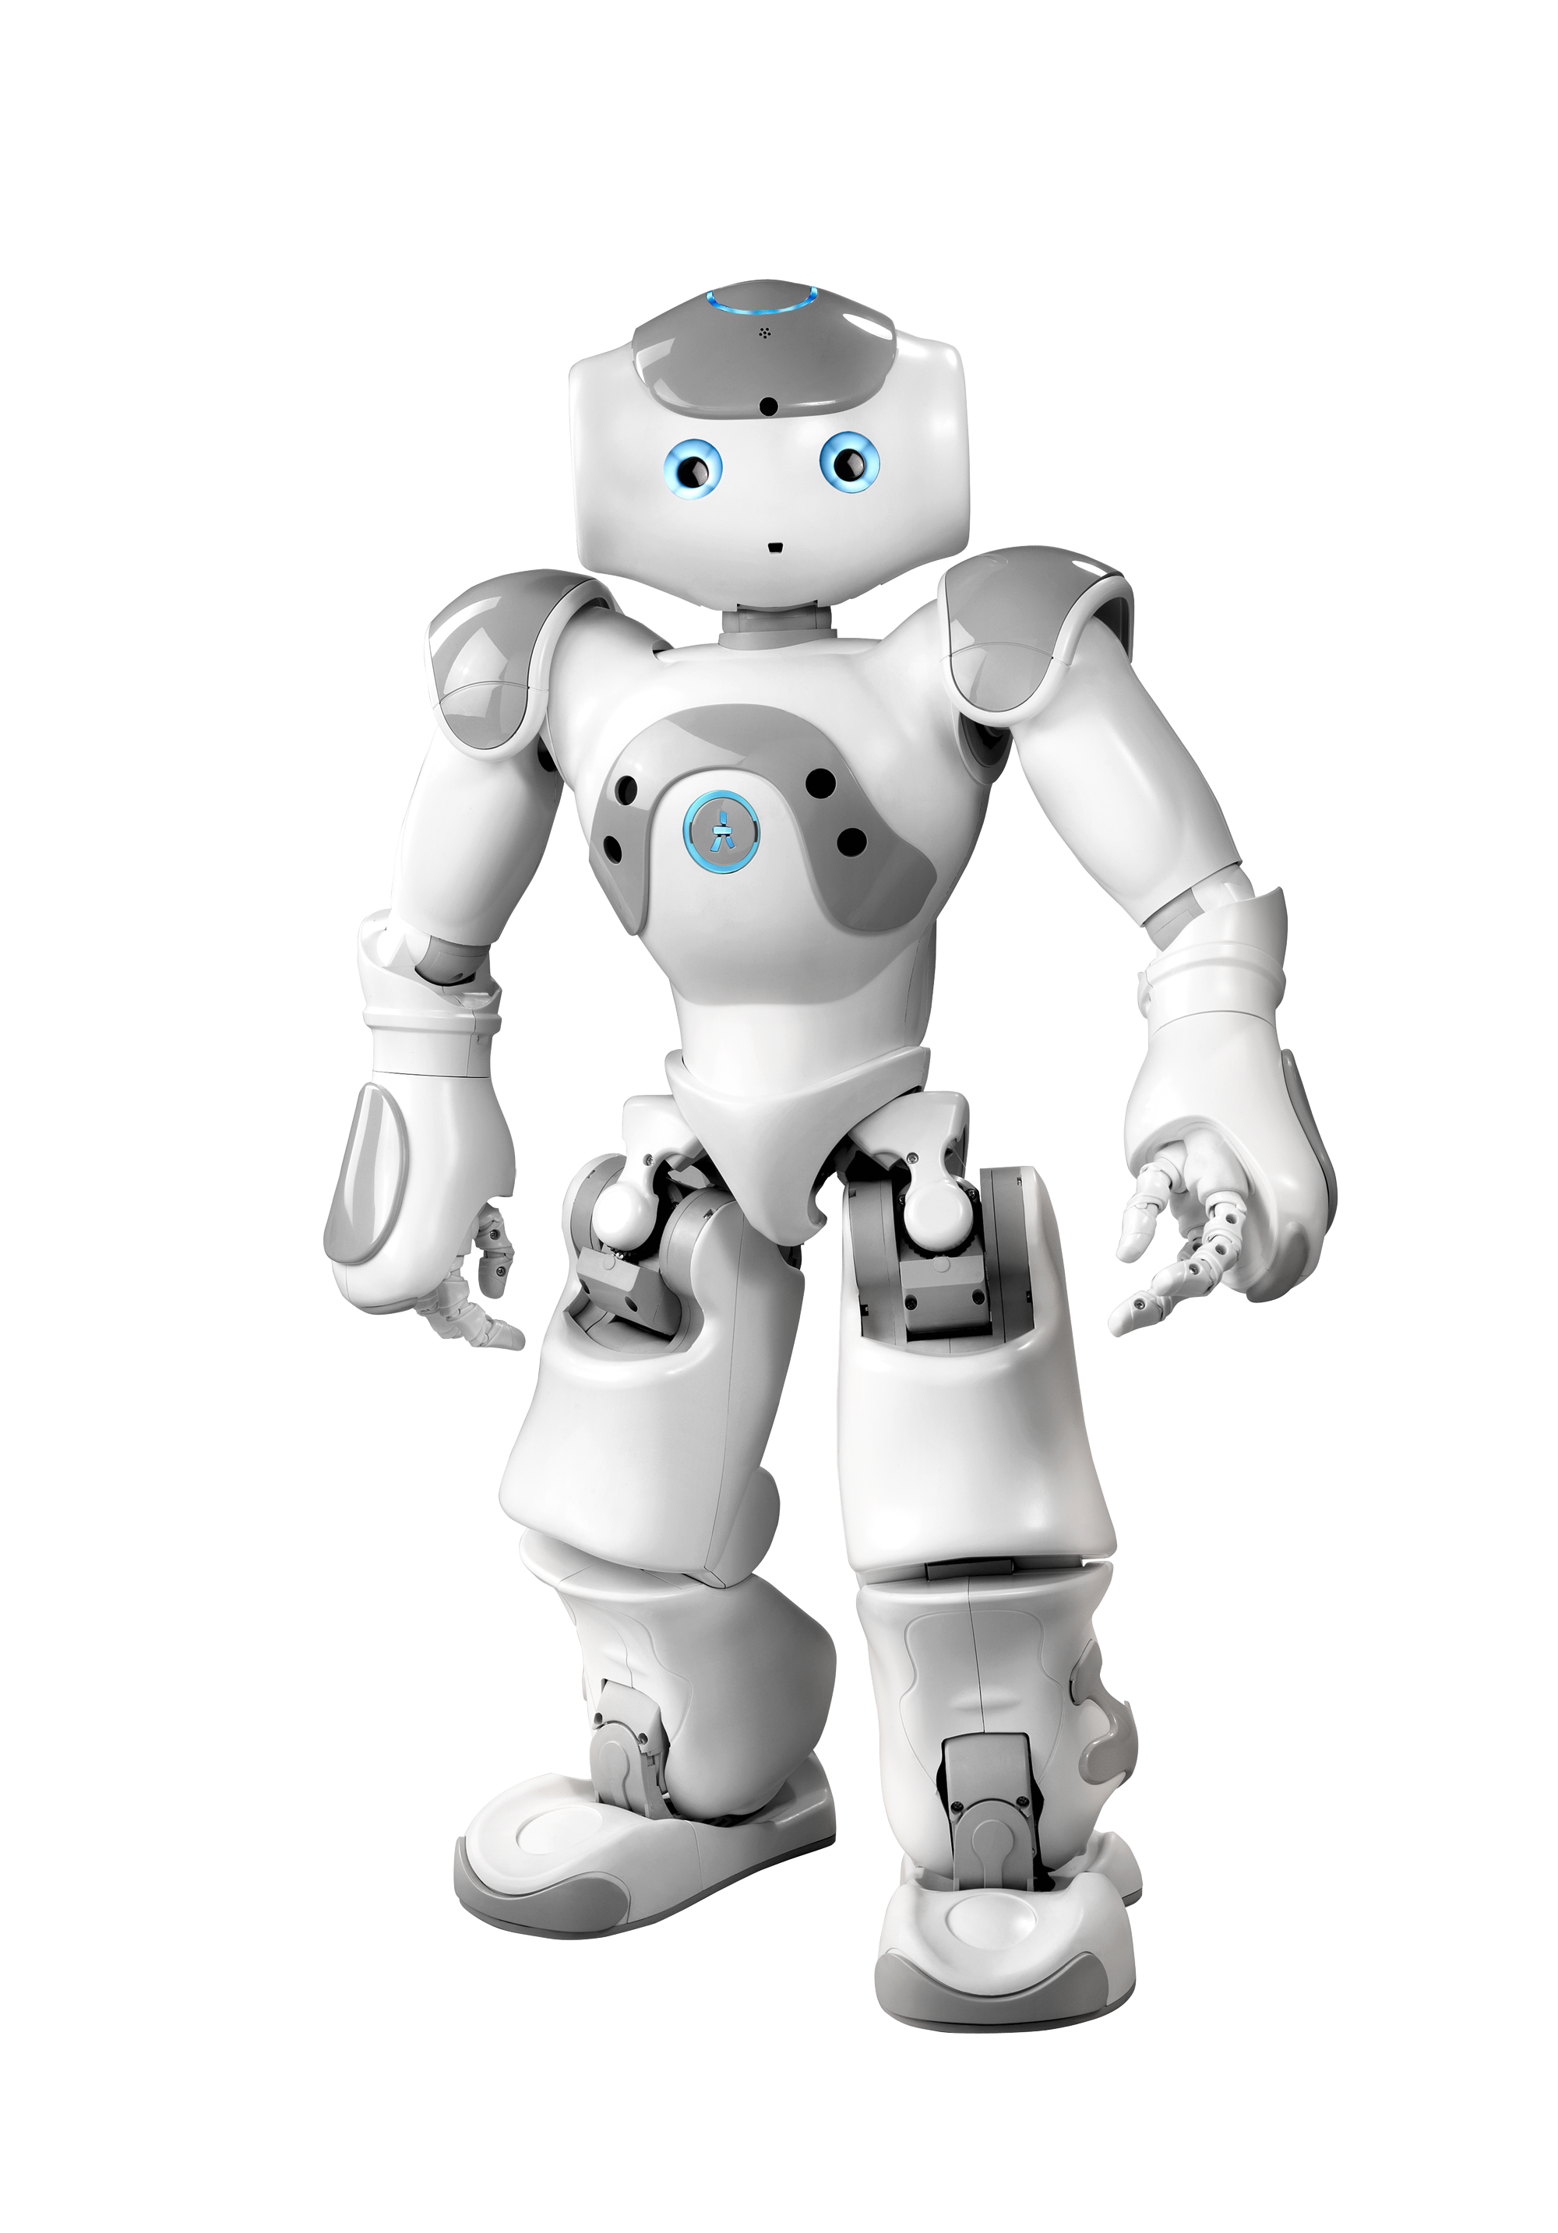
Architettura
Smart Cloud Framework
Wifi
Bluetooth
IR

Slide 4
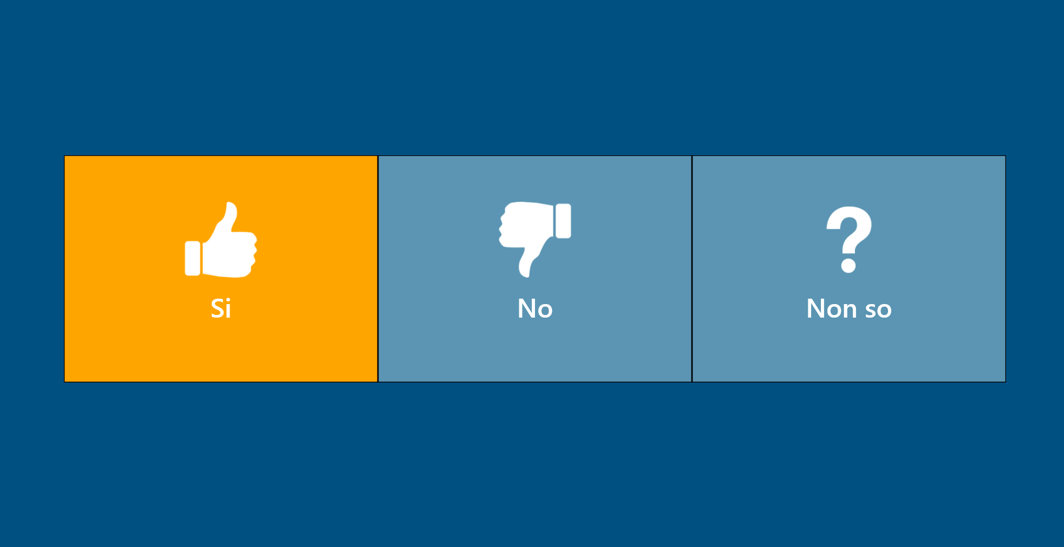
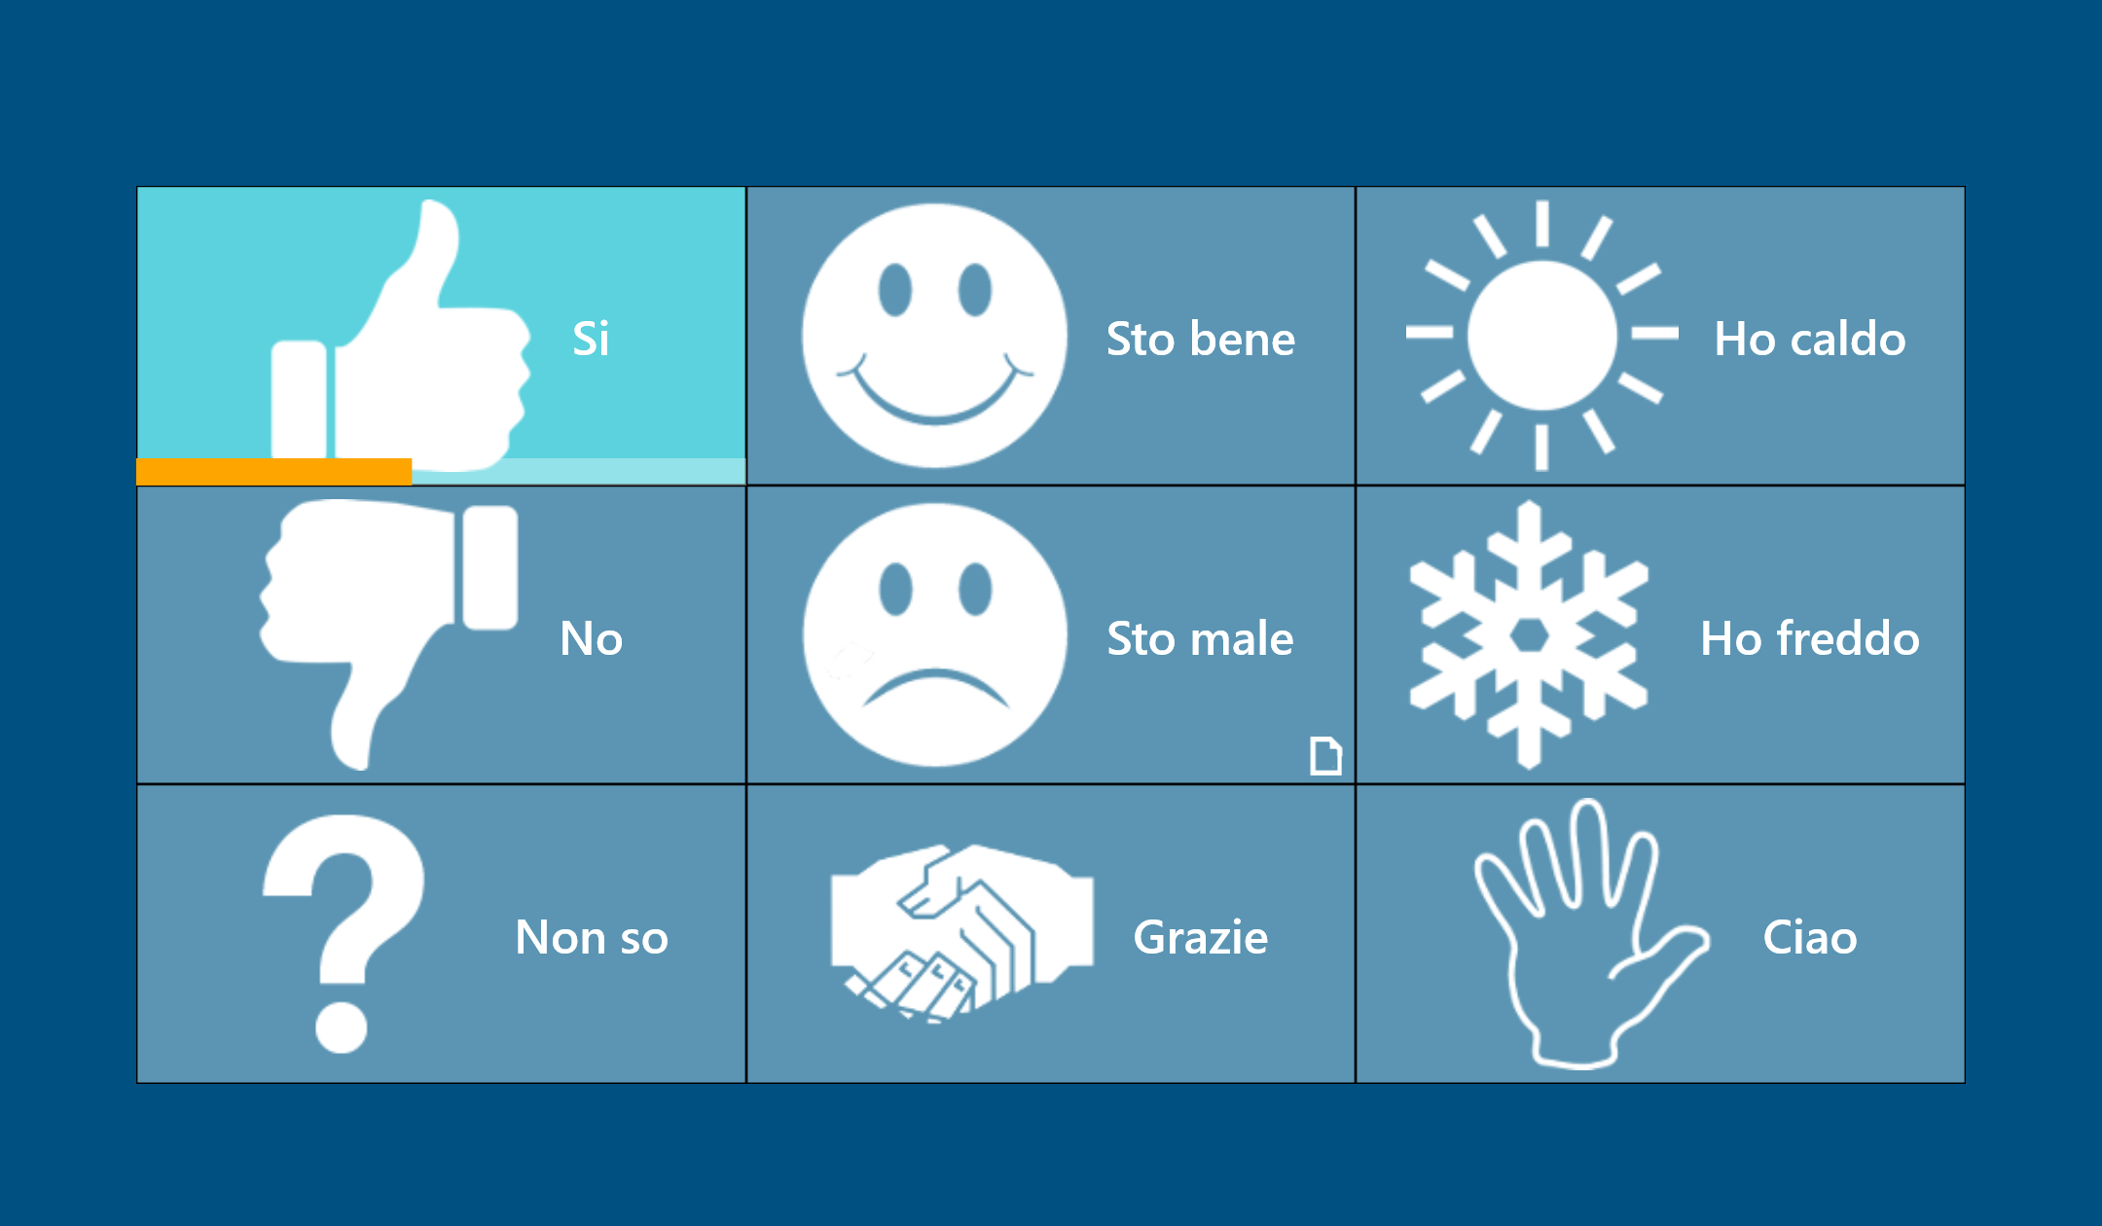
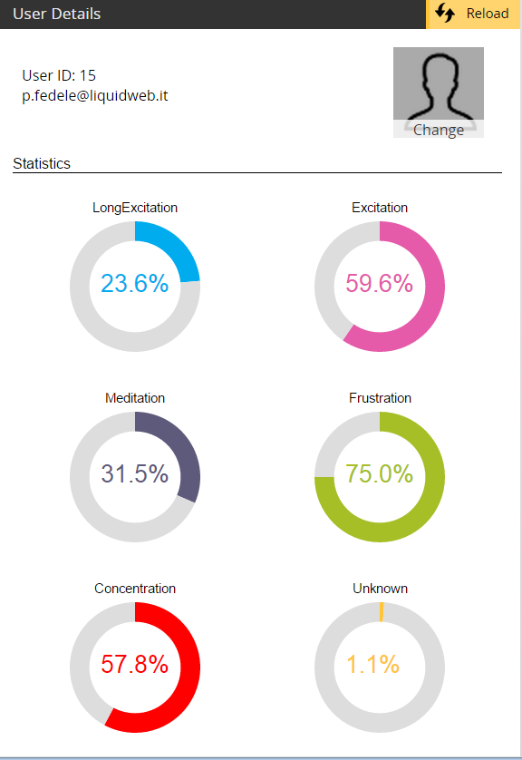
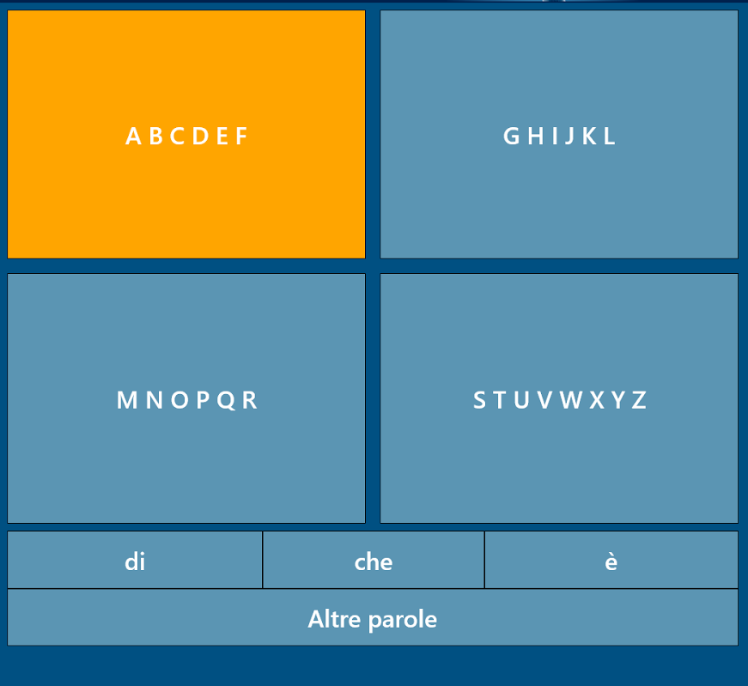
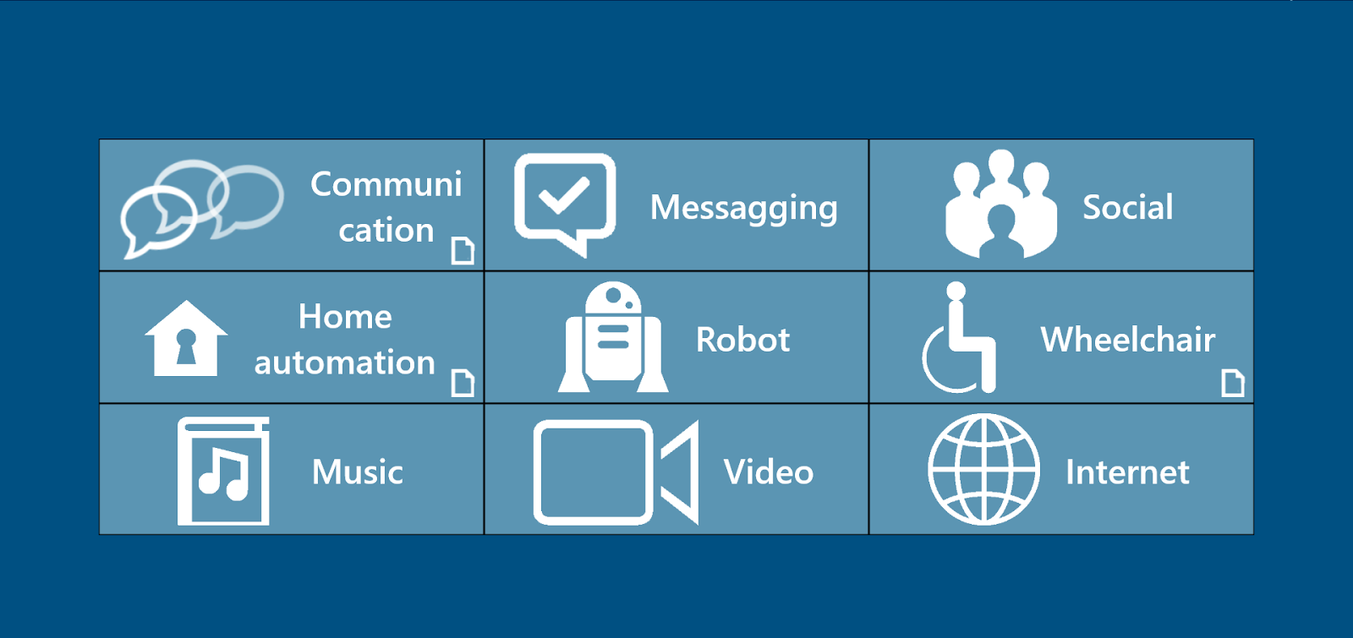
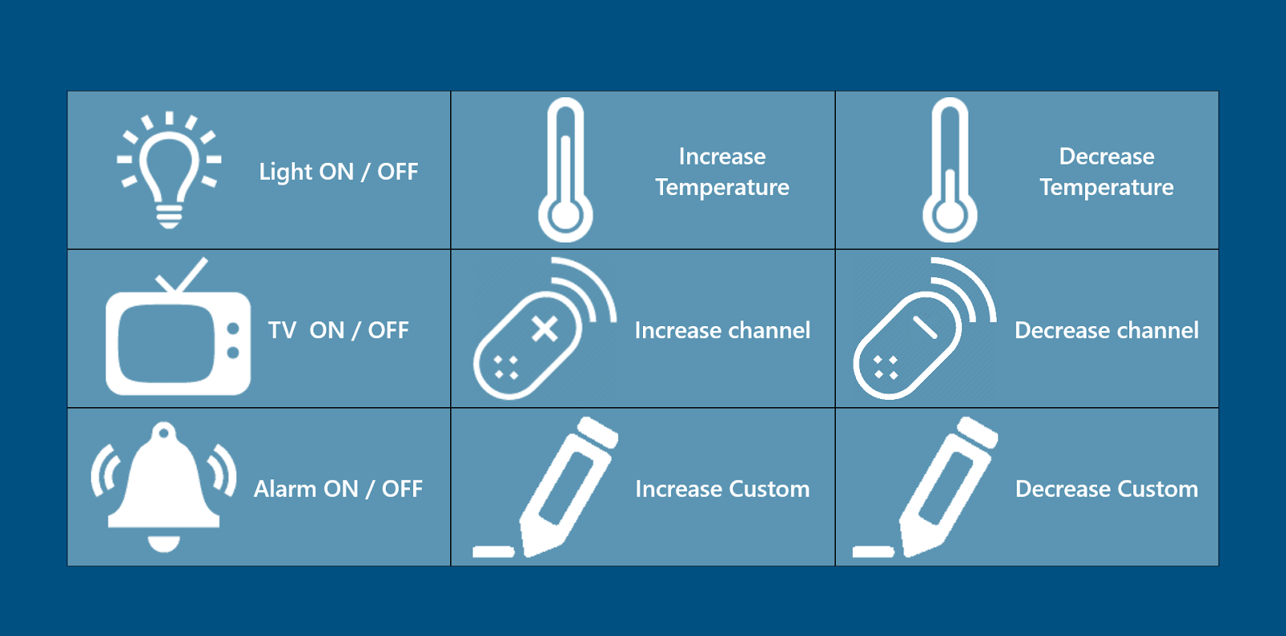
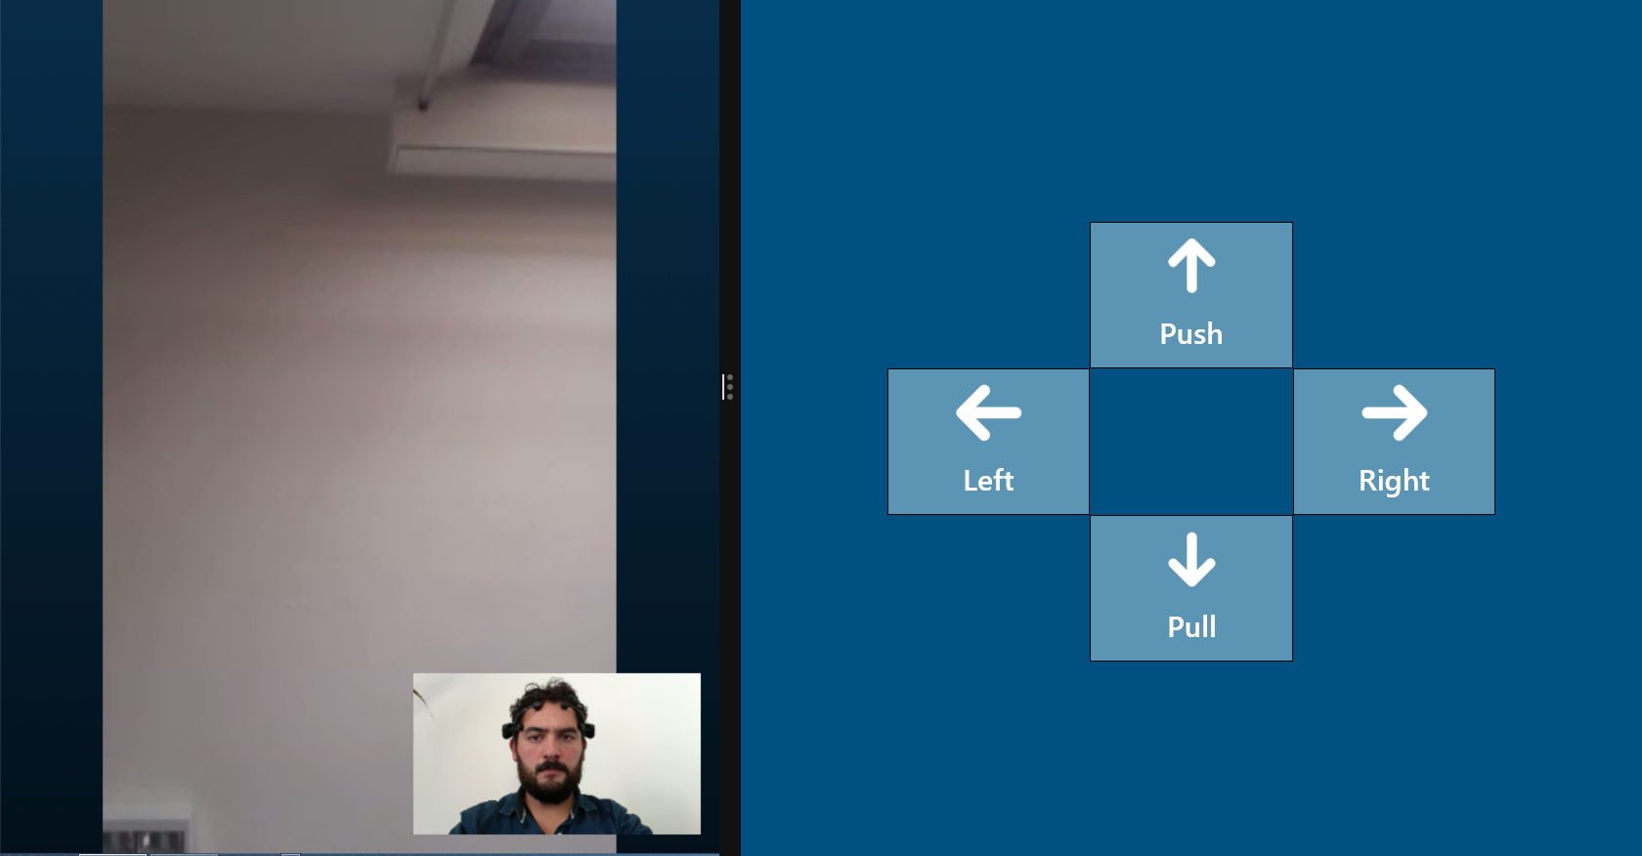
Funzionalità

Slide 5
Pubblicazioni
Alicia Casals, Pasquale Fedele, Muscolo, Carmine Tommaso Recchiuto, Tadeusz Marek, Rezia Molfino, Giovanni Gerardo - A robotic suit controlled by the human brain for people suffering from quadriplegia*. TAROS 2013
P. Fedele, P. Federighi, R. Molfino, G. G. Muscolo, C. T. Recchiuto, A. Rufa - High Energy Efficiency Biped Robot controlled by the Human Brain for people with ALS disease*. 17th IEEE Mediterranean Electrotechnical Conference 2014
Patrizio Tressoldi , Luciano Pederzoli , Marco Bilucaglia , Patrizio Caini ,Pasquale Fedele , Alessandro Ferrini , Simone Melloni , Diana Richeldi ,Florentina Richeldi , Agostino Accardo. Brain-to-Brain (mind-to-mind) interaction at distance: a confirmatory study F1000 Research, 2014
Pasquale Fedele, Chiara Fedele, Jarrod Fath Braincontrol Basic Communicator: A Brain-Computer Interface Based Communicator for People with Severe Disabilities. Springer International Publishing 2014
P. Fedele, G. G. Muscolo, C. T. Recchiuto, A. Rufa . Novel robotic technologies for the assistance of people suffering from Amyotrophic Lateral Sclerosis POR-CREO 2007-2013.

Slide 6
Brevetti
P. Fedele, “Sistema brain-computer interface (BCI) per il controllo di tecnologie assistive”, Italian Patent Pending, n. 102015000008481, March 2015
P. Fedele, “Sistema di controllo di tecnologie assistive e relativo metodo”, Italian Patent Pending, n. 102015000052009, Sptember 2015

